Slide 1
Meet our Mom
Explore the story of one Mom and how her experience demonstrates the role of community service providers in Mothers’ Mental Health.
MoM is a Mothers’ Mental Health Toolkit
Project Learning Video
with Dr. Joanne MacDonald
Reproductive Mental Health Service
IWK Health Centre
Halifax, NS

Slide 2
Meet our Mom MoM
As a community service provider to mothers
and young families you can create opportunities
to promote and support mothers’ mental health.
A mother’s positive mental health promotes
the development of her child in physical growth
and health, a solid self-esteem, confidence and
skill in learning, emotional regulation and
relationship success throughout life.

Slide 3
Meet our Mom MoM
In the series, Meet our Mom MoM, the Mothers’ Mental Health
Toolkit Project team will introduce you to case descriptions drawn
From the real experiences of our mental health clinicians and our
Family Resource Centre partner staff.
These Moms have common presentations and problems that will
challenge you to define your possible role and contributions to her
well being. The Moms will also provide examples of how you might
use some of the Toolkit resources in your work.
Have a copy of your Toolkit out for reference as we begin to
Meet our Moms.
You could also print off this presentation and make notes as you go.

Slide 4
Meet our Mom Lana
Lana is a 17 yo student
20 weeks into unplanned pregnancy
lives in public housing with mother & younger sister
father has left 5 years before family immigrated 10 years ago

Slide 5
Meet our Mom Lana
Lana is referred to your centre by her school nurse
who has heard about verbal conflict with the
boyfriend in common areas and comments from other
girlfriends who visit her office that, “Lana is losing it”
You are starting a new support program for teen
mothers and make the first outreach call to Lana

Slide 6

Meet our Mom Lana
Telephone Contact:
Pregnancy not planned
Hoped to go to community college next year
Boyfriend pressed for termination initially
Now avoiding her texts, partying more with friends.
Lana also used to party on weekends
“ I have to try to stay good for my baby and I’m so tired I’m not fun anymore really”
“I can’t count on those girls I used to hang with anymore anyway.”

Slide 7

Meet our Mom Lana
What are 3 possible mental health issues for Lana?
1.
2.
3.

Slide 8
Meet our Mom Lana
The Toolkit Project Team identified:
Peer relationships are changing; support may be low.
She may have had mood problems before as she thinks hormones are making them ‘worse’.
Possible previous substance use when
‘partying’ as a coping behavior.

Slide 9
Meet our Mom Lana
What would you like to know more about
with this Mom?
1.
2.
3.

Slide 10
Meet our Mom Lana
The Toolkit Team wondered about:
What is her family’s history of mental health problems?
Father’s mother was in hospital after one of her aunts was born.
Has always been a bit of a family mystery.
Father had a history of heavy alcohol misuse; sober now but moved away after parents separated.
Contact 1-2 per year.
Mother has struggled with panic attacks that get so severe in
winter she may not leave the house for days.
Lana’s risk of a mood disorder may be higher than other teen
mothers.

Slide 11
Meet our Mom Lana
The Toolkit Team also wondered about:
2. What were her usual coping strategies?
Being with her girlfriends, talking, listening to music was her favourite way to relax.
She was also a very good soccer player and liked to run hard at practice, run all the tensions out.
She would smoke cannabis but usually only on weekends.
Lana’s usual coping strategies are less possible in pregnancy.

Slide 12
Meet our Mom Lana
The Toolkit Team wondered about:
How long has she been involved with the father of the baby and what has the relationship been like for both of them?
They have been off and on over two years.
Lana wants more of a commitment than he has been comfortable with.
He wonders if she became pregnant to keep him close.
She can become easily insecure and seeks a lot of her self-worth from his every comment and action.
He gets frustrated and says critical things about her, he feels bad about but doesn’t know how to apologize.
Lana may need more skills to communicate positively in relationships while still respecting her needs and safety.

Slide 13

Meet our Mom Lana
What could be the role for you or your organization in
her mental health as a mother?
1.
2.
3.

Slide 14
Meet our Mom Lana
Possible roles and contributions:
A setting that isn’t family or friends, without judgement; acceptance she has difficult moods.
Safe place to explore risks & strengths regarding mental illness risk that is present for her. Connect her wellbeing to her sense of being a ‘good mother’.
Opportunity for new social support with other teen mothers.

Slide 15
Meet our Mom Lana
How might you use the Toolkit resource with Lana
or other teen mothers?
Pages 14 & 15.
The ‘Self-Care Checklist’ can be away to explore her past and present behaviors and priorities

Slide 16
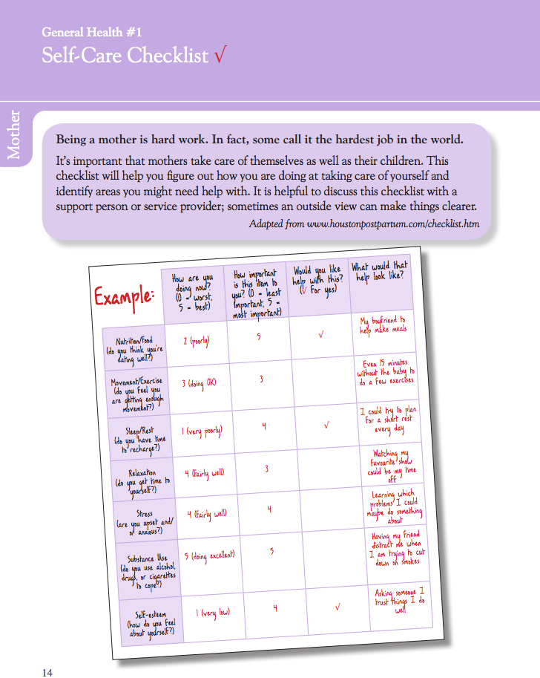

Slide 17
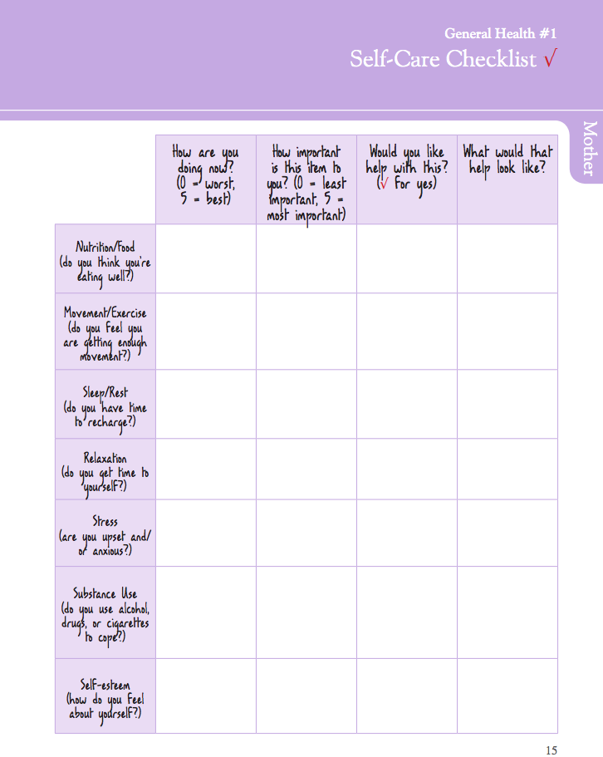

Slide 18

Meet our Mom Lana
Lana used to have organized soccer practice and now is tired, worried about her growing body and isn’t getting out.
Page 27 ‘My Exercise Ideas’ could be a start to reconnecting her to her body health and a positive coping strategy in exercise and physical
release of tension

Slide 19
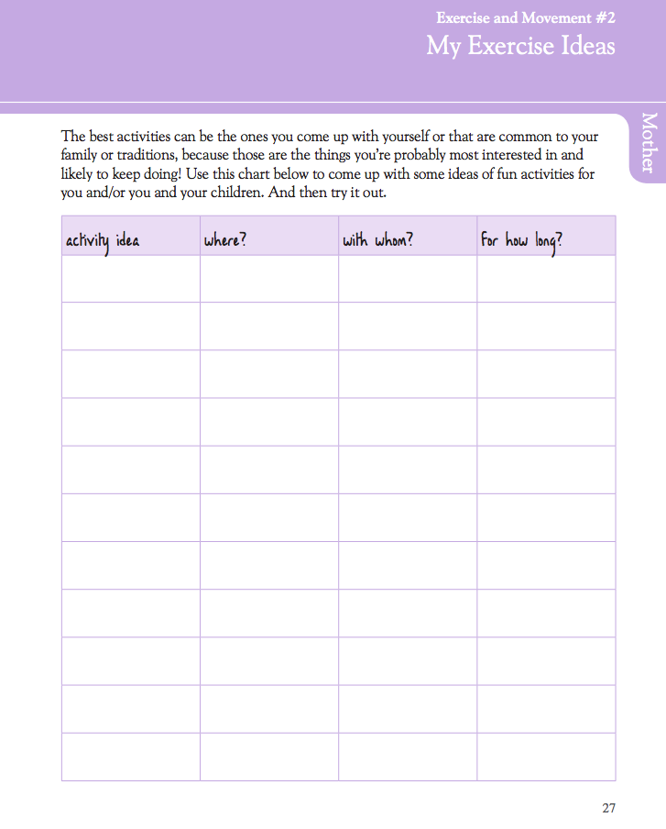

Slide 20
Meet our Mom Lana
Changes and losses in relationships and her usual social supports has been identified
Page 62 ‘You and Your Children: Support Map’ can be a flexible visual way of exploring current and possible new supports as she becomes a mother

Slide 21
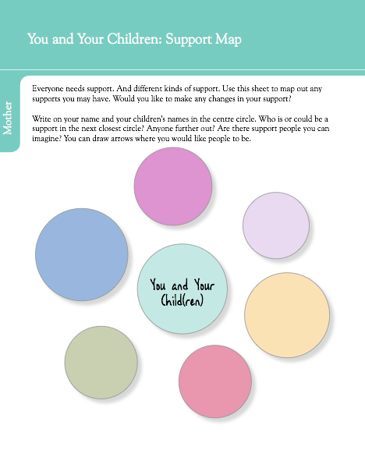

Slide 22

Meet our Mom Lana
Relationships with the baby’s father and family support persons, perhaps Lana’s mother, will be key to her stability in pregnancy and those first few months of change with a young infant
Pages 78 & 79 help to recognize the problems anyone can have with positive communication at times of conflict and how to set realistic goals in any relationship at times of change and stress

Slide 23
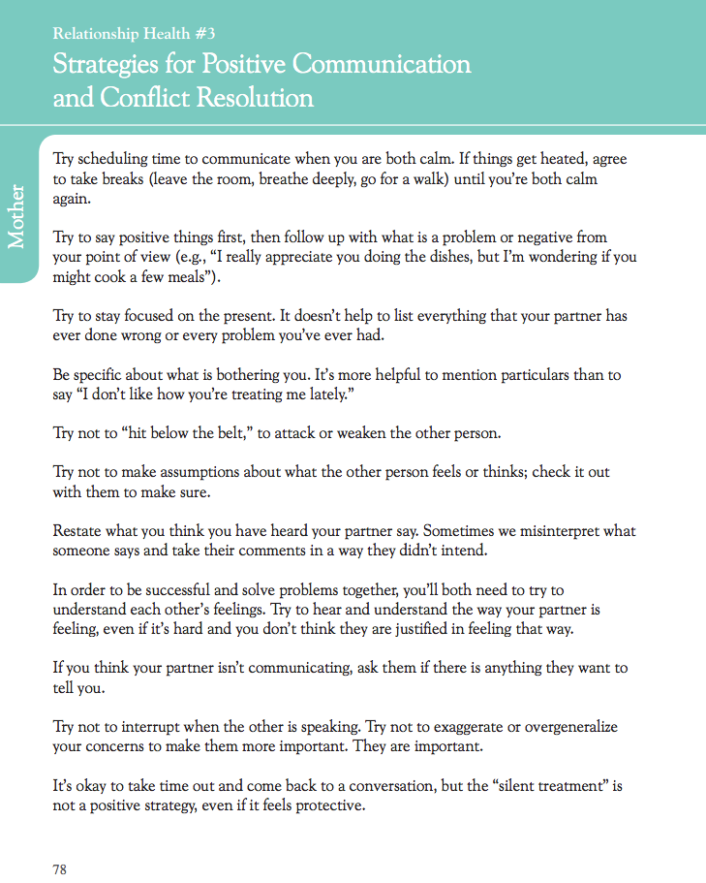

Slide 24
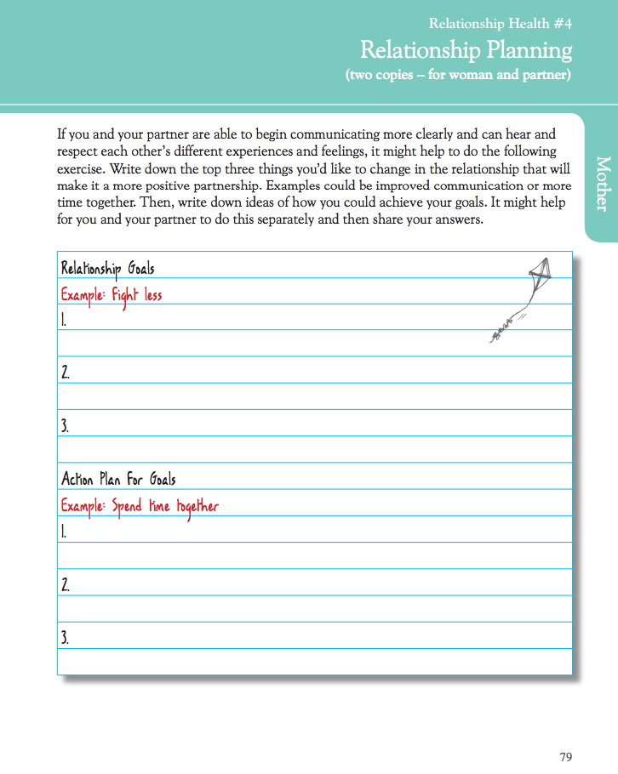

Slide 25

Meet our Mom Lana
Did you see any other resources or exercises in the
Mothers’ Mental Health Toolkit that you thought could
help you with Lana? Or use in the group you are
developing?
Maybe look through and write down the page
numbers you might use.

Slide 26
Meet our Mom Lana
Key Points when working with young mothers:
Peer supports are very important at this stage of life and may be changing with pregnancy; address the loss and positively seek out options for support
Attempt to reduce the stigma around all teen mothers having problems and focus on what priorities this young woman identifies first.
You may see the potential concerns such as the family history of mood problems and higher risk for postpartum depression, but addressing the ‘problem’ as a self-care promotion opportunity.

Slide 27
Meet our Mom Lana
Other Resources:
www.teenmentalhealth.org - a general teen mental
health resource developed at the IWK Health Centre
and Dalhousie, Halifax NS Can
Power Source Parenting :Growing Up Strong & Raising Healthy Kids. Bethany Casarjian PhD. 2008 - a book developed by a psychologist for at risk teen parents; a facilitator’s manual was also developed in 2011. Contact is through Lionheart Press Boston MA USA

