Slide 1
Meet our Mom
Explore the story of one Mom and how her experience demonstrates the role of community service providers in Mothers’ Mental Health.
MoM is a Mothers’ Mental Health Toolkit
Project Learning Video
with Dr. Joanne MacDonald
Reproductive Mental Health Service
IWK Health Centre
Halifax, NS

Slide 2

Meet our Mom MoM
As a community service provider to mothers
and young families you can create opportunities
to promote and support mothers’ mental health.
A mother’s positive mental health promotes
the development of her child in physical growth
and health, a solid self-esteem, confidence and
skill in learning, emotional regulation and
relationship success throughout life.

Slide 3
Meet our Mom MoM
In the series, Meet our Mom MoM, the Mothers’ Mental Health
Toolkit Project team will introduce you to case descriptions drawn
From the real experiences of our mental health clinicians and our
Family Resource Centre partner staff.
These Moms have common presentations and problems that will
challenge you to define your possible role and contributions to her
well being. The Moms will also provide examples of how you might
use some of the Toolkit resources in your work.
Have a copy of your Toolkit out for reference as we begin to
Meet our Moms.
You could also print off this presentation and make notes as you go.

Slide 4
Meet our Mom Julie
Julie is a 28 yo full time mother/homemaker, parenting 6 yo son and 4 mo old daughter
Planned pregnancy with new partner
Living in rural area; partner employed on large farming operation
First weeks postpartum were exciting with new family; comfortable with mothering tasks
Past 6 weeks low energy and motivation, no particular stressors or worries, tearful, not enjoying usual TV shows with partner, avoiding friends’ calls and Facebook

Slide 5

Meet our Mom Julie
Doesn’t know what is wrong
Somewhat irritable with partner, lower patience with son’s activity level
Odd but deepening sense of hopelessness
Finds herself thinking “it just doesn’t seem worth it” but can’t identify triggering incidents
Frightened by intrusive images of car accidents, or the baby falling from her arms
Thought the curtain was moving in a rhythm to the radio; twice heard her name called out

Slide 6

Meet our Mom Julie
What are 3 possible mental health issues for Julie?
1.
2.
3.

Slide 7
Meet our Mom Julie
The Toolkit Project Team identified:
Julie has some possible signs of Postpartum Depression – unexplained low mood, negative thinking not characteristic for the person, low energy and initiative but particularly inability to enjoy herself in usual activities. She is tearful “for no reason” and has unwelcome if still vague thoughts of suicide that are not usual for her.
The curtain moving and the name called out seem to occur without any other trigger; they could be early sensory changes and are a soft warning sign for psychosis, but only if they progress and thinking becomes more distorted, less logical or very unusual, bizarre ideas.
The sudden frightening ideas or images of harm could be obsessional symptoms, which can be a feature of Major Depression as it progresses or a primary Obsessive-Compulsive Diagnosis. Both can be new diagnoses in the postpartum period. Obsessions are thoughts, images or sensations that feel forced, not welcome, far from the usual ideas or intent of that woman.

Slide 8

Meet our Mom Julie
What would you like to know more about with this Mom?
1.
2.
3.

Slide 9
Meet our Mom Julie
The Toolkit Team wondered about:
Has Julie ever experienced these kinds of feelings and thoughts before?
Julie recalls a similar period of low mood, lack of energy, concentration and initiative and passive suicidal thinking without any intent to harm herself in the Fall about 10 years ago. Her mother had died 6 months before the symptoms began just as Julie thought she was adjusting to the loss.
She thinks the family doctor back home put her on some kind of medication

Slide 10
Meet our Mom Julie
The Toolkit team also wondered:
2. Is there any family history of post-baby mental health problems? Of mental illness in general?
Julie doesn’t know her father’s side of the family very well. She asks more and finds out her father’s mother had very changeable mood with highs and lows. She wonders if she may have been an undiagnosed Bipolar Disorder. Her maternal aunt and a maternal cousin both have suffered with recurrent depressive episodes.

Slide 11

Meet our Mom Julie
Our last question was:
3. What was Julie’s experience like after her son was born 6 years ago?
Julie felt very well physically and emotionally after Josh was born, even though his father was always out with friends, had a gambling problem and didn’t seem interested in the baby at all. She is very happy with her new partner and surprised by how ‘hands on’ he wants to be with both children. She keeps saying she has to “shake this thing I’m feeling”; she doesn’t feel like her ‘usual self’.

Slide 12
Meet our Mom Julie
What could be the role for you or your organization in her mental health as a mother?
1.
2.
3.

Slide 13
Meet our Mom Julie
Possible roles and contributions :
She has talked about some very troubling thoughts and feelings with you; this suggests a low sense of stigma for the mother and encourages disclosure of problems.
2. Community awareness and screening for postpartum mental health problems is a key to early diagnosis, treatment and recovery.
3. The knowledge that obsessional thoughts can be experienced with depression and are not typically signs of psychosis helps you educate and calm the mother who experiences them. There are effective treatments, both medications and psychotherapy.

Slide 14
Meet our Mom Julie
How might you use the Toolkit resource with Julie?
First step is to help Julie recognize she is an experienced mother and so her overwhelming fatigue and confusion, and lack of enjoyment with her baby girl are atypical for her. She needs screening for a Postpartum Mood Disorder.
Pages 138-140 explain and give an example of a screening tool used with new mothers

Slide 15
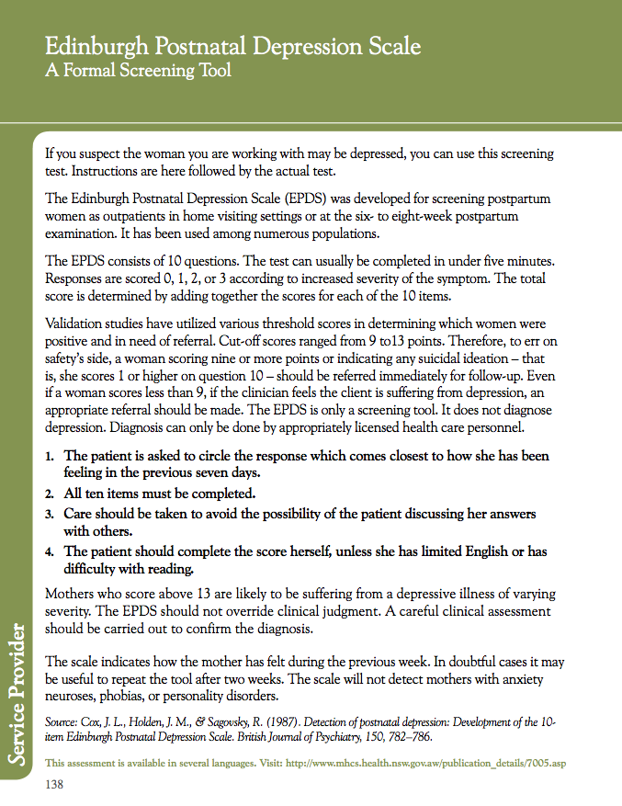

Slide 16
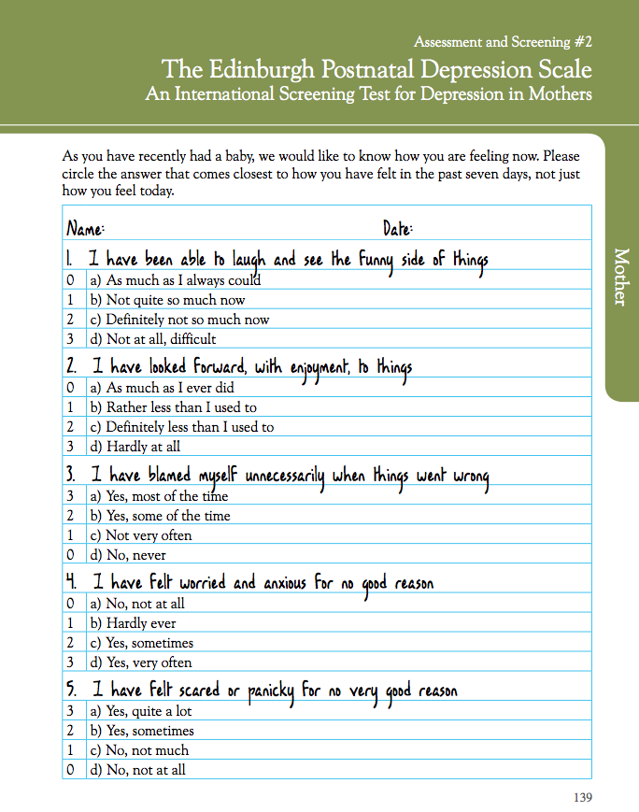

Slide 17
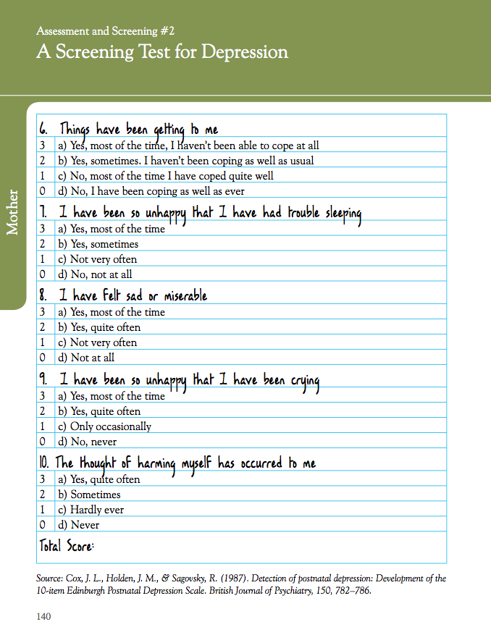

Slide 18
Meet our Mom Julie
Julie is confused by how much she is struggling after this baby, and not after her son when her life in general was much more stressful.
Pages 115-117, The Three Parts of Us All
helps any woman understand how family history, our sense of self, and our social experiences can increase or decrease the risk of a mental health problem

Slide 19
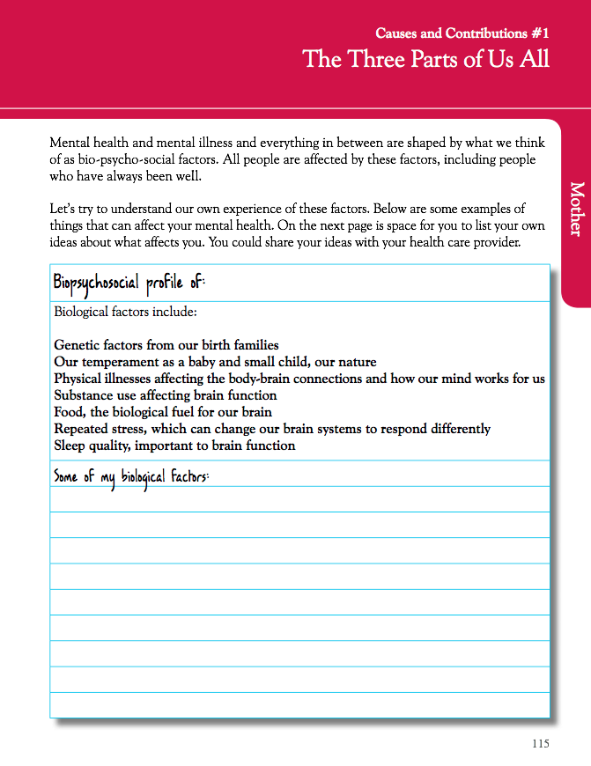

Slide 20
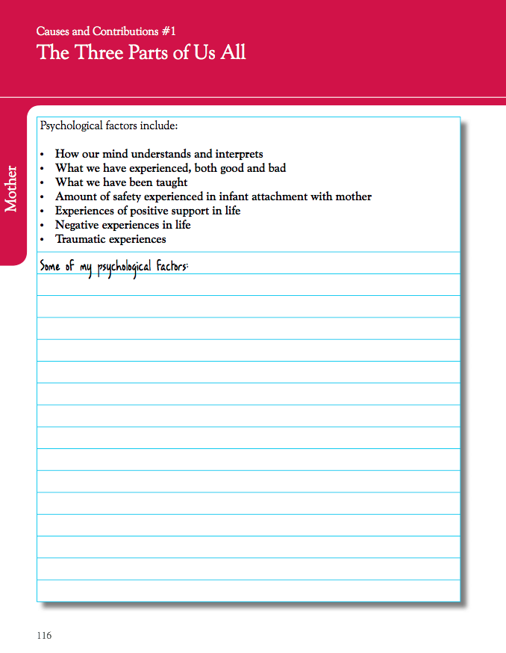

Slide 21
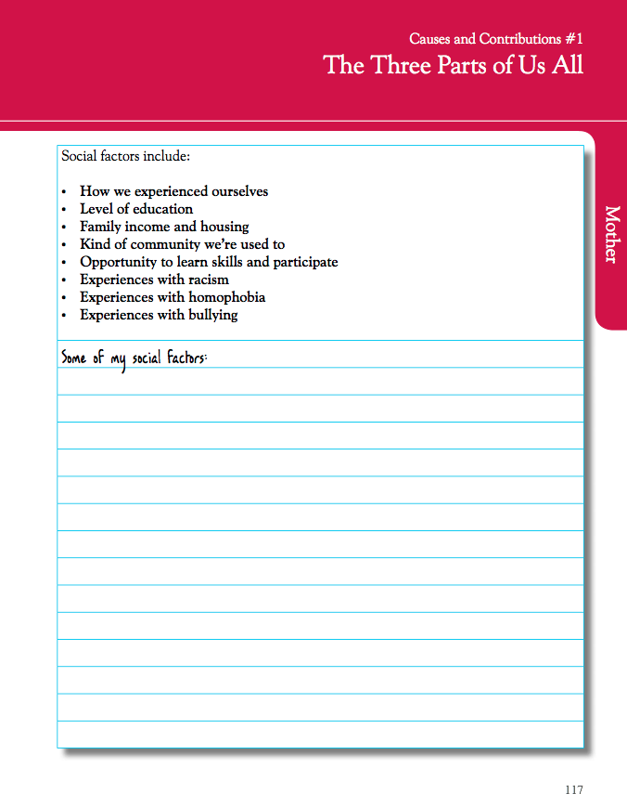

Slide 22
Meet our Mom Julie
How would I recognize the early signs of a postpartum psychosis?
Psychosis is a term that refers to loss of a sense of reality – in what a person sees, feels, hears, or thinks. It is generally a brain illness and if thinking and impulses are very unusual or involve harm to herself or her children, this is a true medical emergency. You may want to have the numbers of emergency services in your area already prepared.
Pages 124 & 125 contain descriptions of Postpartum Psychosis Page 156 shows one example of a map of local services you might need to support a woman with an emerging mental illness

Slide 23
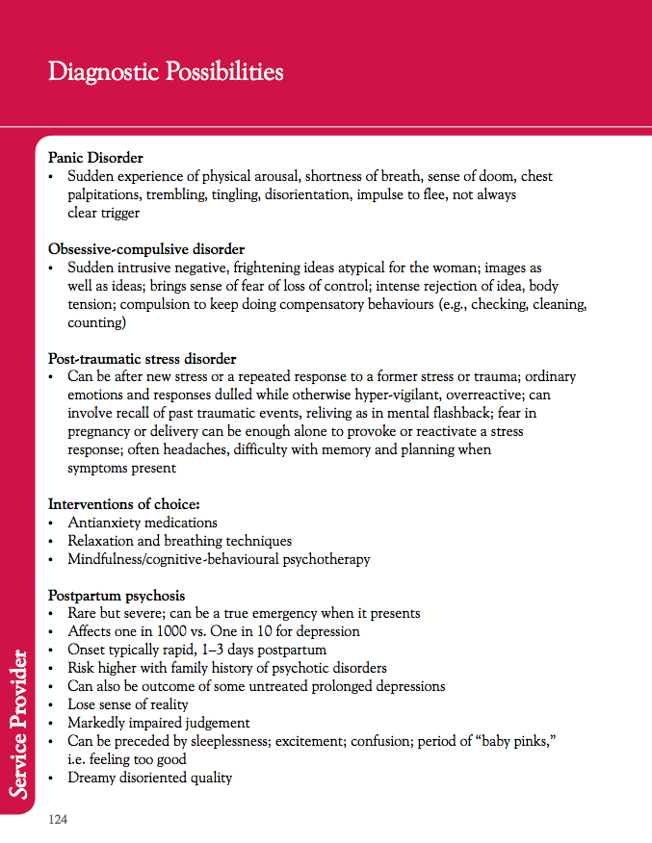

Slide 24
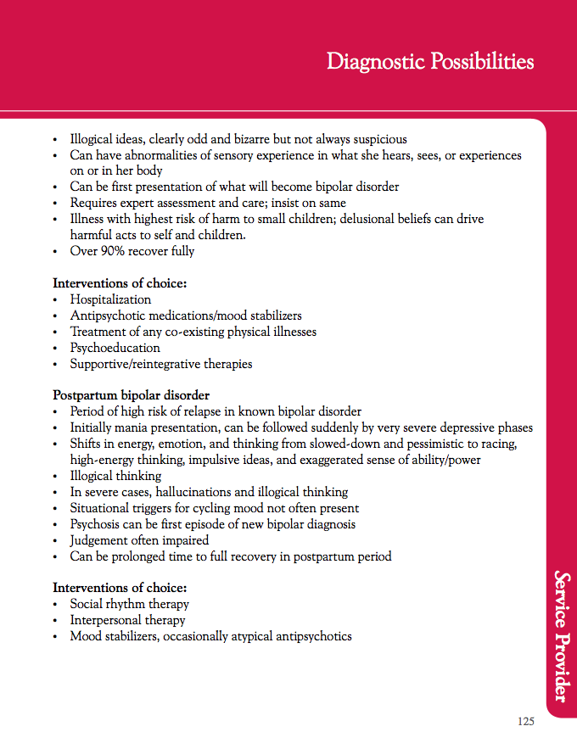

Slide 25
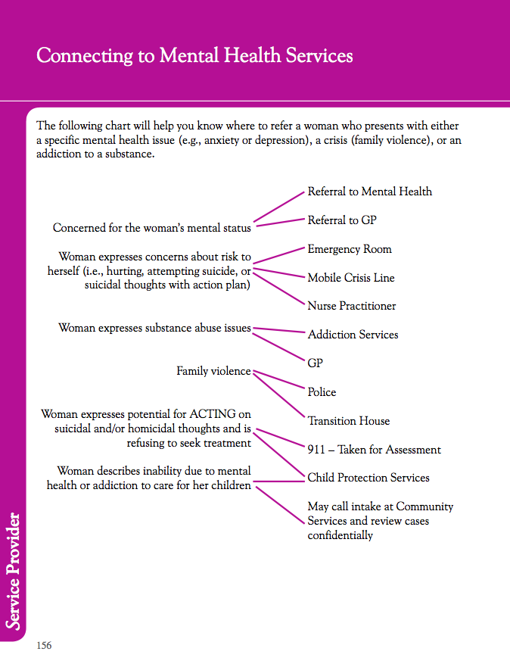

Slide 26
Meet our Mom Julie
Key points in working with Postpartum Depression
At least 1 in 10 women who give birth will present with a Postpartum Depression of moderate severity, affecting daily function. Like Julie they may not experience this with every pregnancy.
It is key to understand if the symptoms you think might be depression are usual for this mom, or new, getting worse and not explainable by her current stressors.
Recovery can be very good with treatment for over 80% of women with Postpartum Depression. They shouldn’t delay assessment, support and treatment.

Slide 27
Meet our Mom Julie
Other Resources:
www.motherisk.org – A Canadian website through the Sick Kids hospital that provides up-to-date information on the safety of all kinds of medication in pregnancy and breastfeeding. They also have a call-in line.
Down Came The Rain – This book written by the actress Brooke Shields, is a very brave and accurate description of the experience of a more severe depression, but with a full recovery and a willingness to share her story.

